Slide 1
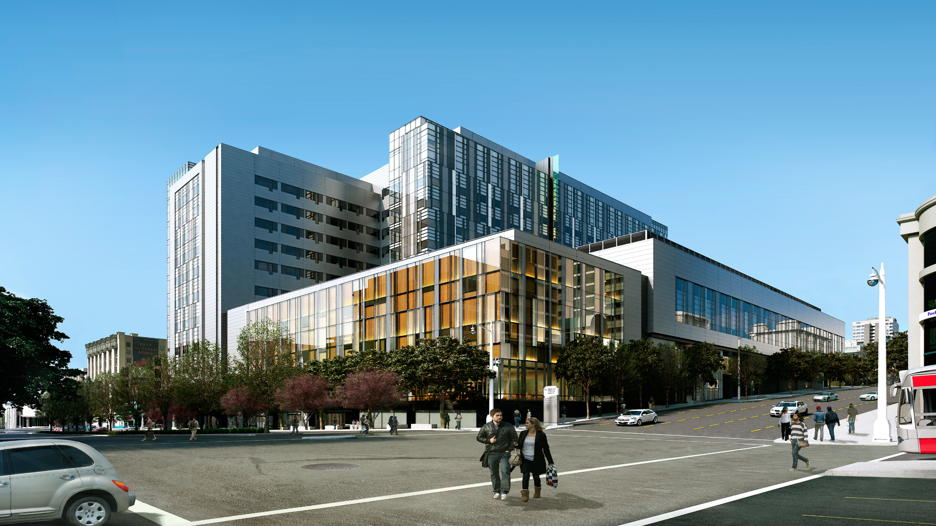
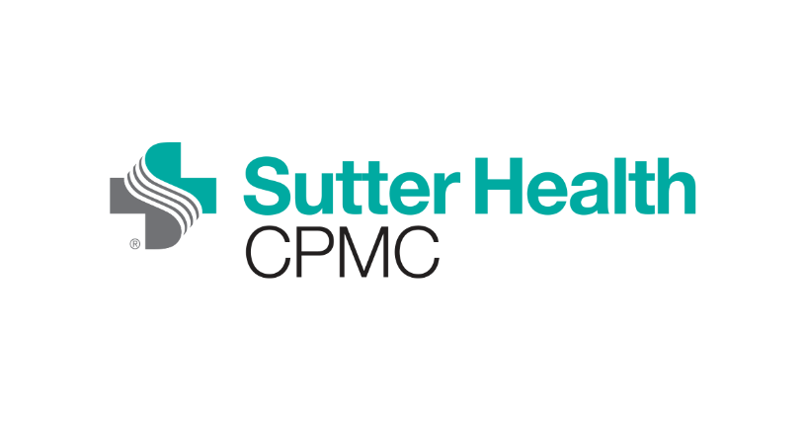
Van Ness
San Francisco residents will have a modern new hospital at their doorstep. Sutter debuts its new California Pacific Medical Center (CPMC) Van Ness Campus hospital on March 2, 2019. The facility represents a milestone community investment in the health of San Francisco and the first new hospital in the heart of the city in a generation.
The state-of-the-art facility, featuring 11 floors and 274 acute-care beds, houses inpatient services with an emphasis on maternity care, pediatrics, orthopedics, transplant, emergency and cardiac care, among other primary care services. Every detail of the new hospital is geared toward creating an inclusive, healing environment, where high quality, technology, safety, efficiency and personal touches will continue to be the norm.

